Slide 1




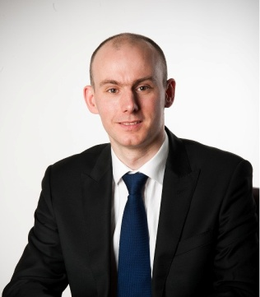
Meet the Executive
Michael Driscoll
Vice Chancellor
Melvyn Keen
Deputy Chief Executive
Estates and Facilities
Academic Registry
Library and Student Support International campuses
Business Development
Academic Partnerships
IWBL
CCSS
Peter Vermeulen
Deputy Vice Chancellor
Waqar Ahmad
Deputy Vice Chancellor
Academic
Research and Knowledge Transfer
Learning and Teaching
Financial Services
Planning
Human Resources
Katie Bell
Deputy Vice Chancellor
Marketing
Recruitment
Student Experience
Employability
Regional Offices
Notes:
MD: appointed 1997, one of longest serving VC in UK
WA: overall responsibility for academic, research and KT management and development
KB: student recruitment through the whole cycle to enrolment
MK: business development international and UK. Corporate services (not finance and HRS)
PV: financial strategy Human resources

